Slide 1
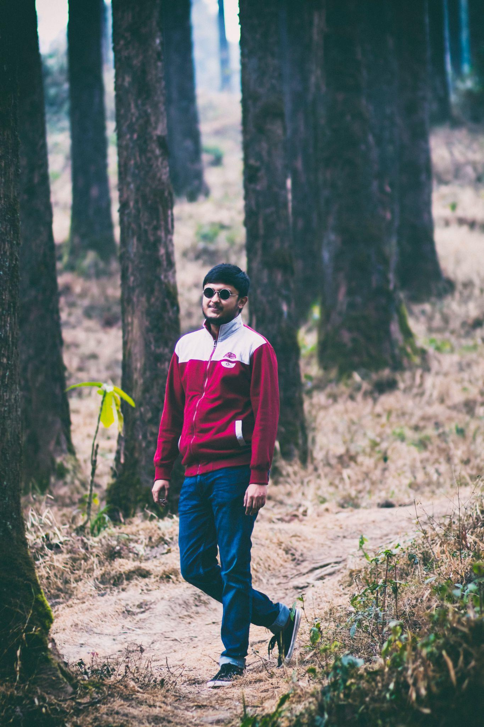

Enabling Possibilities with Open-Source in Machine Learning
Sayak Paul (@RisingSayak)
MLE, Carted
India

Slide 2
$whoami
I call model.fit() at Carted.
Profound interest in open-source (keras-io, addons, hub, neural-structured-learning).
Netflix Nerd 🎥
Coordinates at: sayak.dev.

Slide 3
Why does this talk exist?
ML and open-source, both are vast and intertwined.
How one (irrespective of their background) can effectively navigate through these two fully-connected worlds?
Specific scopes of open-source in ML.
Improving as an ML practitioner with open-source contributions.

Slide 4
Some 101s
Open-source works without finite expectations.
It benefits from mutual trust and flourishes from constructive dialogue.
This compels communities to contribute primarily for better enablement.
Rest of things then become secondary - stars, apparent rewards, competition, etc.

Slide 5
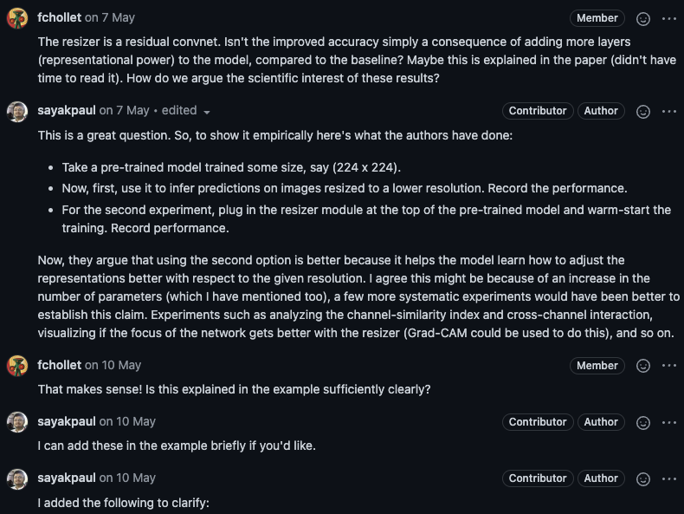
Challenges in ML benefited by open-source
Thriving for transparency
keras-team/keras-io/pull/455

Slide 6
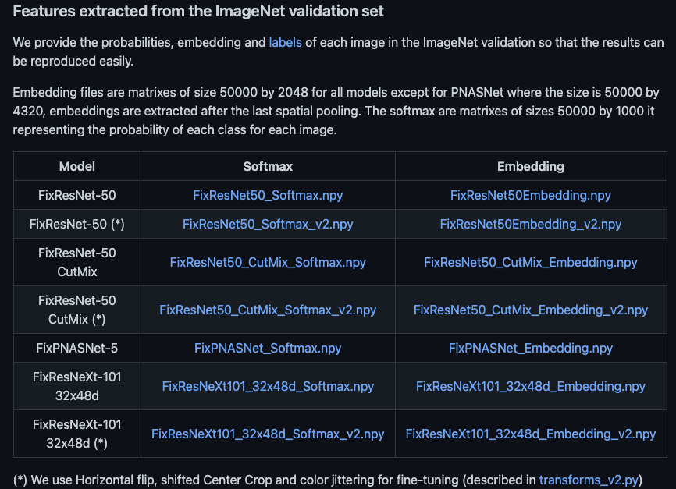
Challenges in ML benefited by open-source
Thriving for transparency
Reproducibility
facebookresearch/FixRes

Slide 7
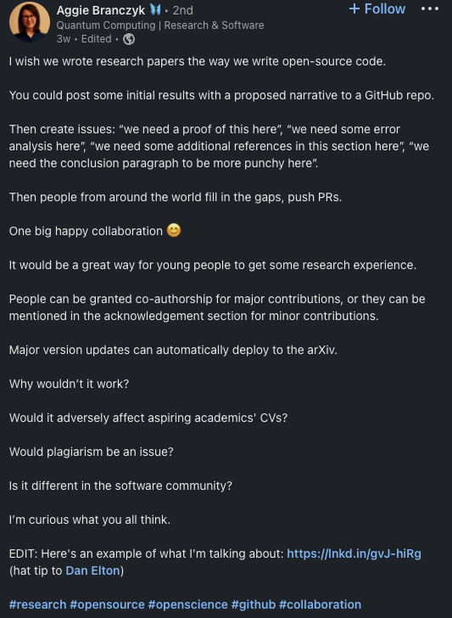
Challenges in ML benefited by open-source
Thriving for transparency
Reproducibility
Open collaboration & mentorship

Slide 8
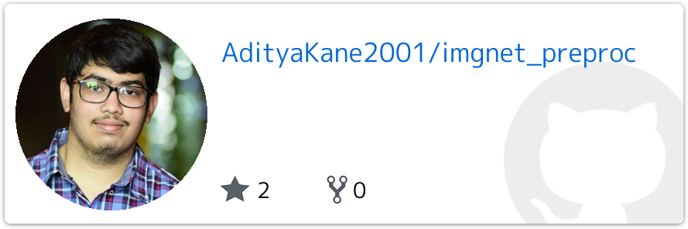
Challenges in ML benefited by open-source
Thriving for transparency
Reproducibility
Open collaboration & mentorship
Reusability

Slide 9
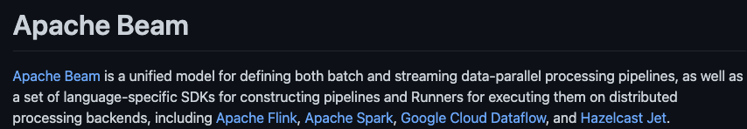
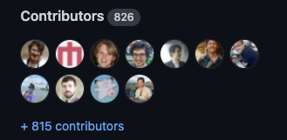
Challenges in ML benefited by open-source
Thriving for transparency
Reproducibility
Open collaboration & mentorship
Reusability
Maintenance

Slide 10
This is why open-source is at the core of the ML research and tooling.

Slide 11
Vehicle to create opportunities

Slide 12
Vehicle to create opportunities
Got something you can explain better?
Code a demo project (paper, Kaggle competition, ML concepts, etc.).
Write a blog post.
Get feedback and improve.
It doesn’t need to be a very recent topic (Facebook vs. Orkut).

Slide 13
Take it from the good folks ...

Slide 14
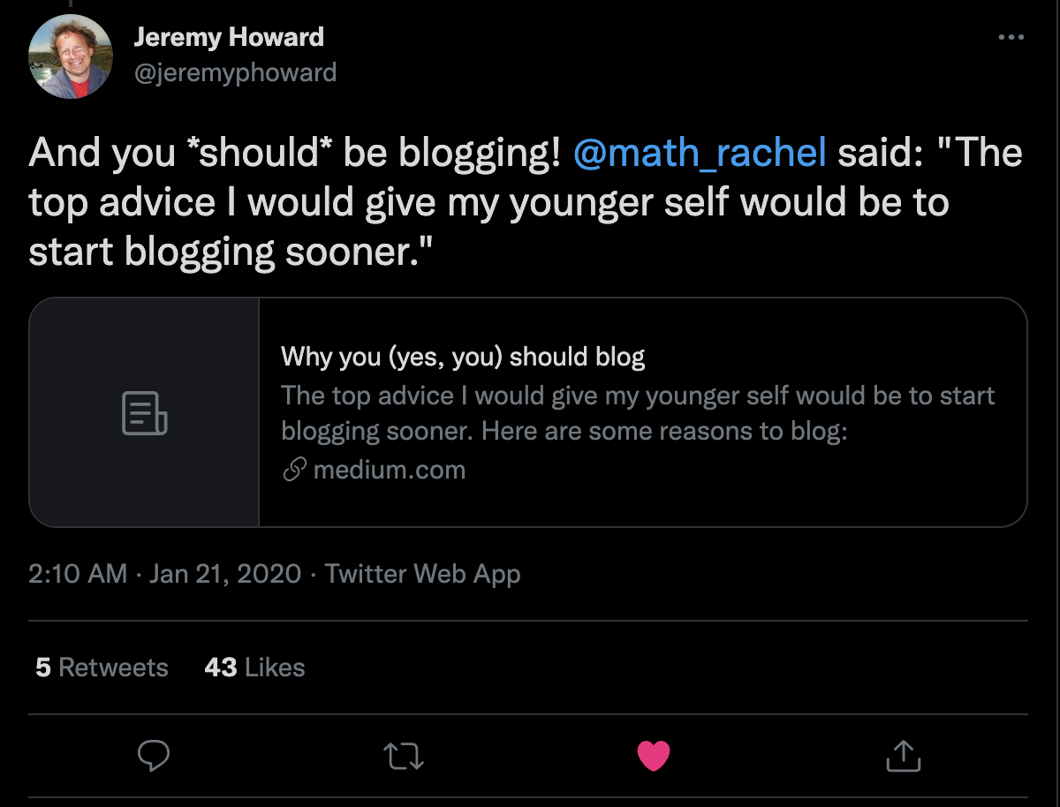
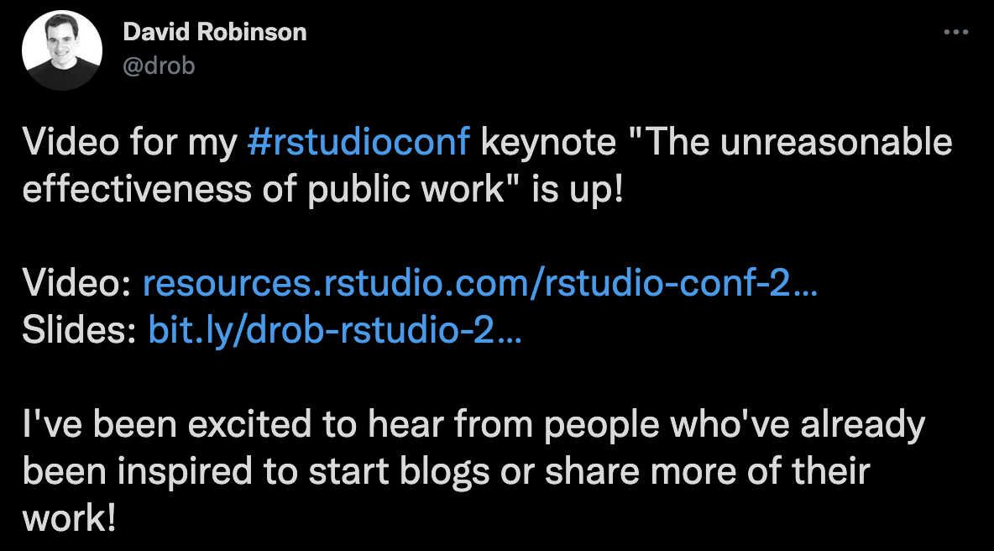
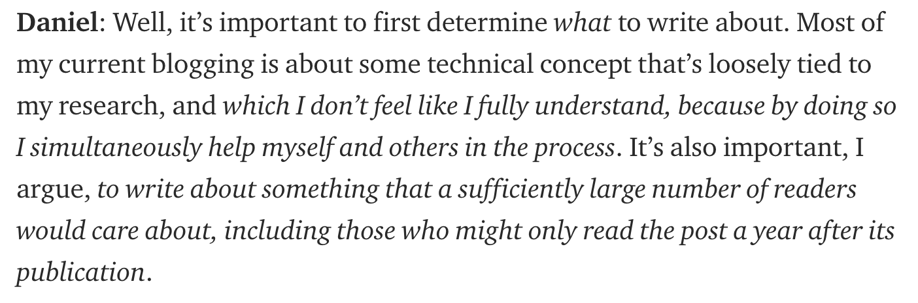
Interview excerpt from: bit.ly/dan-seita

Slide 15
Stalwarts make their work public to benefit the community.

Slide 16
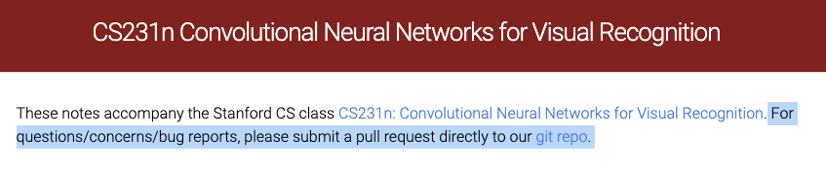
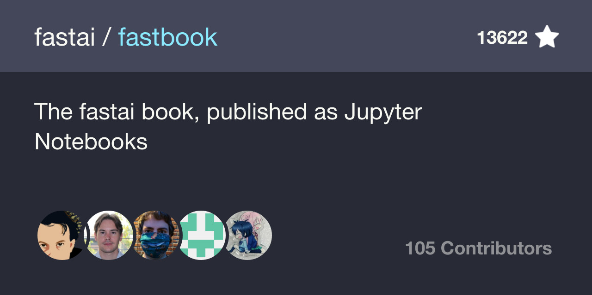
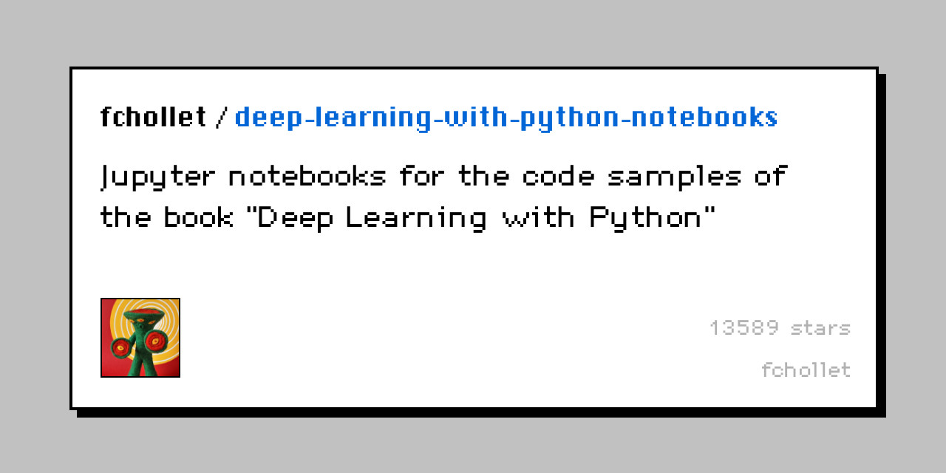
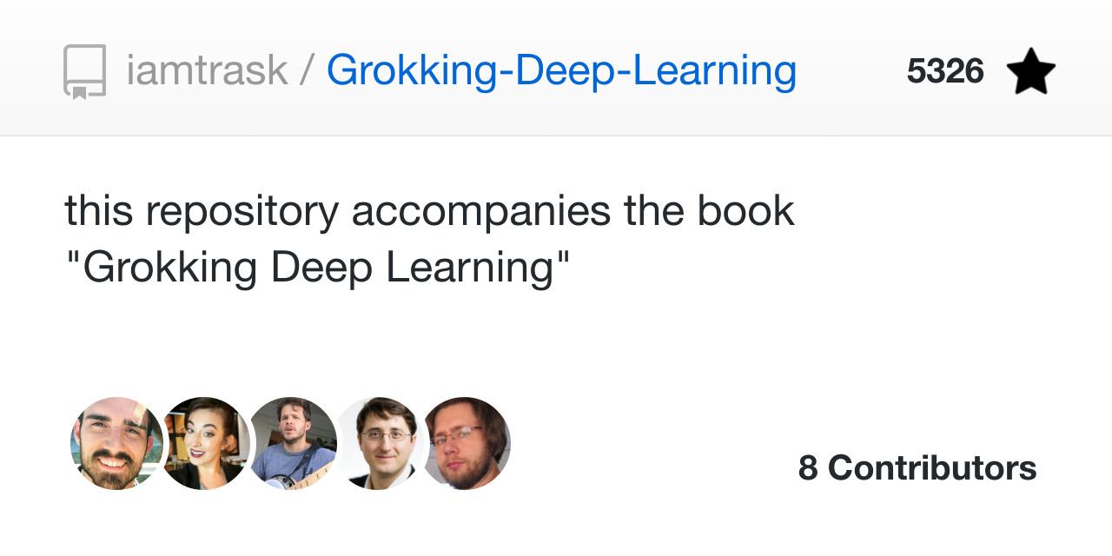
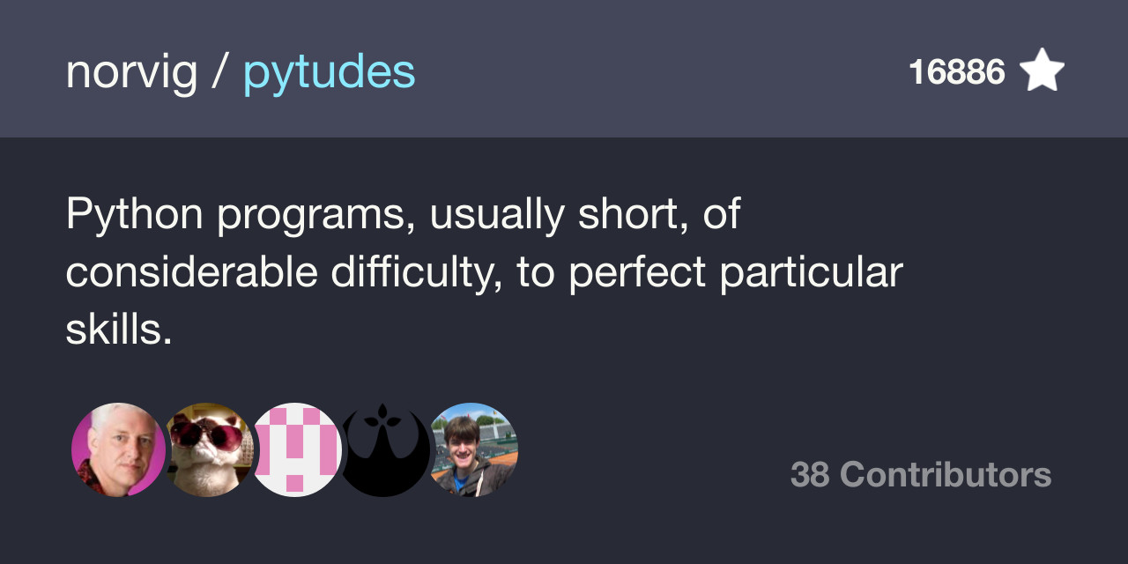

Slide 17
Vehicle to create opportunities
Got something you can explain better?
Want to improve documentation?
Open a PR and contribute directly.

Slide 18
Vehicle to create opportunities
Got something you can explain better?
Want to improve documentation?
Want to contribute a module to an ML library or improve it?
Impact thousands and thousands of users.

Slide 19
Vehicle to create opportunities
Got something you can explain better?
Want to improve documentation?
Want to contribute a module to an ML library or improve it?
Found bugs in your favorite open-source library?
File an issue.
Take part in the relevant discussions.
Help make the library better.

Slide 20
Vehicle to create opportunities
Got something you can explain better?
Want to improve documentation?
Want to contribute a module to an ML library or improve it?
Found bugs in your favorite open-source library?
Take it even further!
Develop a library on your own.

Slide 21
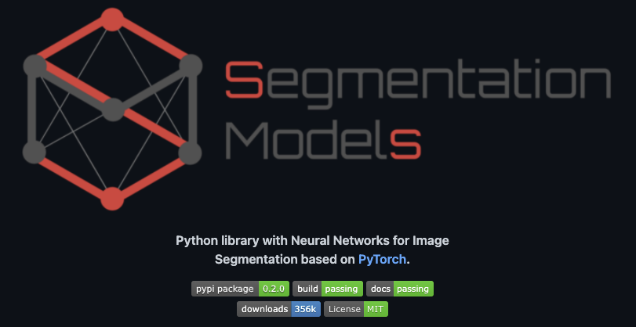
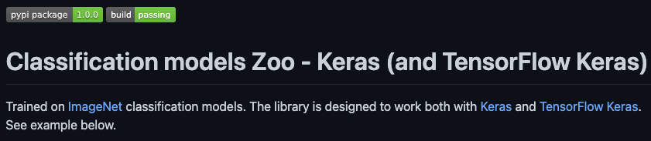
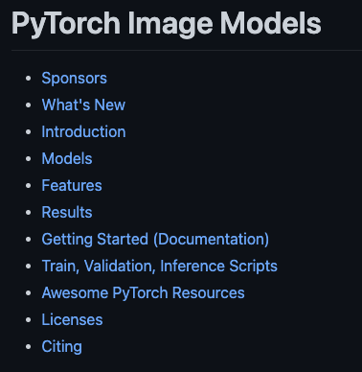
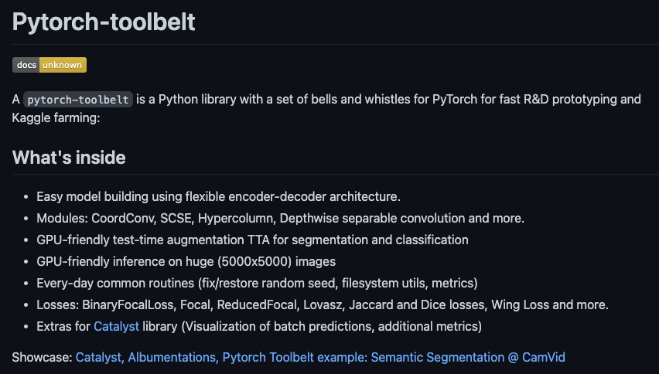

Slide 22
What would have happened if ...

Slide 23







… these weren’t open-source and started charging for usage?

Slide 24

"you can't stand on the shoulders of giants if they keep their shoulders private"
Credits: Joel Grus

Slide 25
It’s likely hard to realize without being involved in open-source (even remotely).

Slide 26


Slide 27
Open-source speaks for your skills
You’re already in a better place if you’ve
Contributed something major to a popular open-source library.
Topped a competition and open-sourced your solution.
Written things with unmatched clarity.
Maintained something on a consistent basis.

Slide 28
Open-source speaks for your skills
You’re already in a better place if you’ve
Contributed something major to a popular open-source library.
Topped a competition and open-sourced your solution.
Written things with unmatched clarity.
Maintained something on a consistent basis.
Basically, anything and everything that uniquely positions you for your abilities.

Slide 29
But also
Remember
Perseverance and consistency are keys.
Give yourself enough time to reflect back and question the purpose.
Be in it for the fun and excitement.

Slide 30
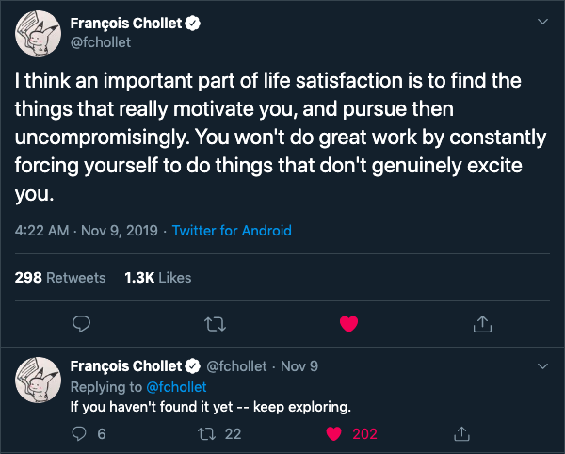
One
cannot
beat your self-drive.

Slide 31


